Slide 1

B
Ishan A & Logan B
A
I. PROJECT GOAL
Purpose
Dataset
Classify violations
Help officers make informed decisions
Montgomery County Traffic Violations
42 attributes
An Analysis of Predictive Models for Classifying Traffic Violations

Slide 2
B
A
Ishan A & Logan B
I. PROJECT GOAL
Purpose
Dataset
Classify violations
Help officers make informed decisions
Montgomery County Traffic Violations
42 attributes
An Analysis of Predictive Models for Classifying Traffic Violations

Slide 3
B
C
A
Ishan A & Logan B
A
B
II. Dataset DESCRIPTION
I. PROJECT GOAL
Skew
Missing Values
Dataset
Purpose
Size
Few ESERO
Fewer SERO
Montgomery County Traffic Violations
42 attributes
Classify violations
Help officers make informed decisions
3.4 million missing
7 main attributes
1.9 million instances
42 attributes
An Analysis of Predictive Models for Classifying Traffic Violations

Slide 4
B
C
A
A
B
II. Dataset DESCRIPTION
Skew
Missing Values
Size
Purpose
Dataset
Few ESERO
Fewer SERO
Classify violations
Help officers make informed decisions
3.4 million missing
7 main attributes
Montgomery County Traffic Violations
42 attributes
1.9 million instances
42 attributes

Slide 5
A
B
C
III. PRE
PROCESSING
Size
Missing Values
Skew
1.9 million instances
42 attributes
3.4 million missing
7 main attributes
Few ESERO
Fewer SERO
A
B
C
Random Sampling
Cleaning
D
Attribute Removal
Stratified
0.5%
Repair Order (ESERO + SERO)
Extraction
E
Python
CSV library
Removed “, ‘, \n, \r
ID
Address
Agency
HAZMAT
Search specifics
Splitting
Description
Alcohol revamp
Speeding
Stratified
80-20 split

Slide 6
C
B
A
III. PRE
PROCESSING
Skew
Missing Values
Size
Few ESERO
Fewer SERO
3.4 million missing
7 main attributes
1.9 million instances
42 attributes
A
B
C
Random Sampling
Cleaning
D
Attribute Removal
Stratified
0.5%
Repair Order (ESERO + SERO)
Extraction
E
Python
CSV library
Removed “, ‘, \n, \r
ID
Address
Agency
HAZMAT
Search specifics
Splitting
Description
Alcohol revamp
Speeding
Stratified
80-20 split

Slide 7
III. PRE
PROCESSING
A
Random Sampling
Stratified
0.5%
Repair Order (ESERO + SERO)
B
C
Cleaning
D
Attribute Removal
Extraction
E
Python
CSV library
Removed “, ‘, \n, \r
ID
Address
Agency
HAZMAT
Search specifics
Splitting
Description
Alcohol revamp
Speeding
Stratified
80-20 split

Slide 8
A
B
C
Size
Missing Values
Skew
1.9 million instances
42 attributes
3.4 million missing
7 main attributes
Few ESERO
Fewer SERO
A
B
Random Sampling
Cleaning
Stratified
0.5%
Repair Order (ESERO + SERO)
Python
CSV library
Removed “, ‘, \n, \r
C
D
Attribute Removal
Extraction
E
ID
Address
Agency
HAZMAT
Search specifics
Splitting
Description
Alcohol revamp
Speeding
Stratified
80-20 split

Slide 9
A
B
C
Size
Missing Values
Skew
1.9 million instances
42 attributes
3.4 million missing
7 main attributes
Few ESERO
Fewer SERO
A
B
C
Random Sampling
Cleaning
Attribute Removal
Stratified
0.5%
Repair Order (ESERO + SERO)
Python
CSV library
Removed “, ‘, \n, \r
ID
Address
Agency
HAZMAT
Search specifics
D
Extraction
E
Splitting
Description
Alcohol revamp
Speeding
Stratified
80-20 split

Slide 10
A
B
C
Size
Missing Values
Skew
1.9 million instances
42 attributes
3.4 million missing
7 main attributes
Few ESERO
Fewer SERO
A
B
C
Random Sampling
Cleaning
D
Attribute Removal
Stratified
0.5%
Repair Order (ESERO + SERO)
Extraction
Python
CSV library
Removed “, ‘, \n, \r
ID
Address
Agency
HAZMAT
Search specifics
Description
Alcohol revamp
Speeding
E
Splitting
Stratified
80-20 split

Slide 11
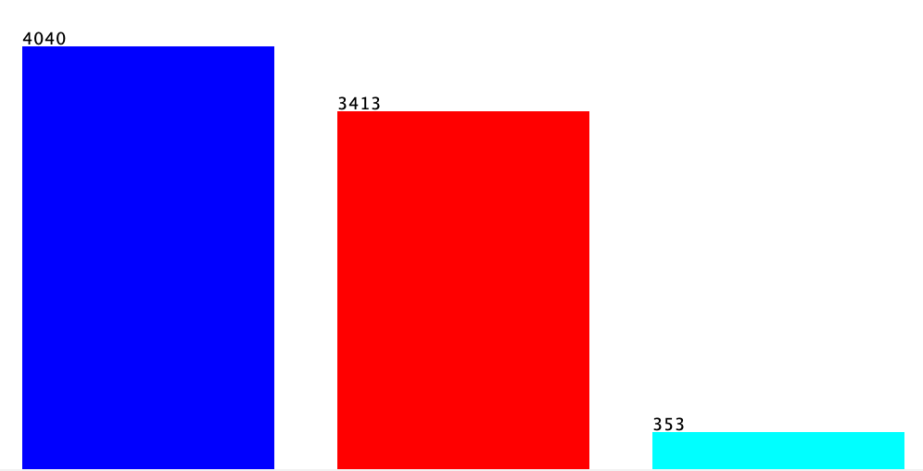
A
B
C
Size
Missing Values
Skew
1.9 million instances
42 attributes
3.4 million missing
7 main attributes
Few ESERO
Fewer SERO
A
B
C
Random Sampling
Cleaning
D
Attribute Removal
Stratified
0.5%
Repair Order (ESERO + SERO)
Extraction
E
Python
CSV library
Removed “, ‘, \n, \r
ID
Address
Agency
HAZMAT
Search specifics
Splitting
Description
Alcohol revamp
Speeding
Stratified
80-20 split
Final Stats
Train: 7806 instances
Test: 1952 instances
29 attributes
51.76% warnings
43.72% citations
4.52% repair orders
Warning
Citation
Repair Order

Slide 12
A
B
C
A
B
C
Random Sampling
Cleaning
D
Attribute Removal
Stratified
0.5%
Repair Order (ESERO + SERO)
Extraction
Missing Values
Skew
Size
Python
CSV library
Removed “, ‘, \n, \r
E
ID
Address
Agency
HAZMAT
Search specifics
Splitting
Description
Alcohol revamp
Speeding
1.9 million instances
42 attributes
3.4 million missing
7 main attributes
Few ESERO
Fewer SERO
Stratified
80-20 split
A
B
Final Stats
IV. ATTRIBUTE SELECTION
Selection Algorithms
Classification
Train: 7806 instances
Test: 1952 instances
29 attributes
51.76% warnings
43.72% citations
4.52% repair orders
Warning
Citation
Repair Order

Slide 13
A
Ishan A & Logan B
B
Final Stats
IV. ATTRIBUTE SELECTION
Selection Algorithms
Classification
Train: 7806 instances
Test: 1952 instances
29 attributes
51.76% warnings
43.72% citations
4.52% repair orders
An Analysis of Predictive Models for Classifying Traffic Violations
Warning
Citation
Repair Order

Slide 14
Ishan A & Logan B
A
B
IV. ATTRIBUTE SELECTION
Selection Algorithms
Classification
An Analysis of Predictive Models for Classifying Traffic Violations
InfoGain
GainRatio
OneR
WrapperSubset
Self-Chosen

Slide 15
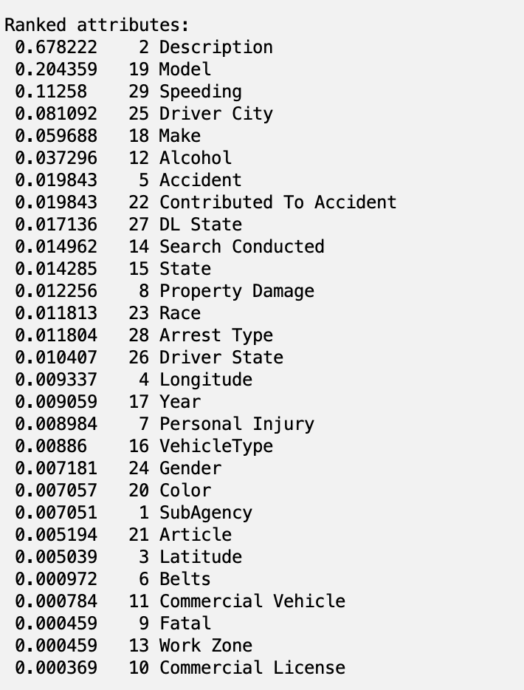
A
B
Selection Algorithms
Classification
IV. ATTRIBUTE SELECTION
InfoGain
GainRatio
OneR
WrapperSubset
Self-Chosen
InfoGain
Split on attribute to minimize entropy
Cutoff of 0.05

Slide 16
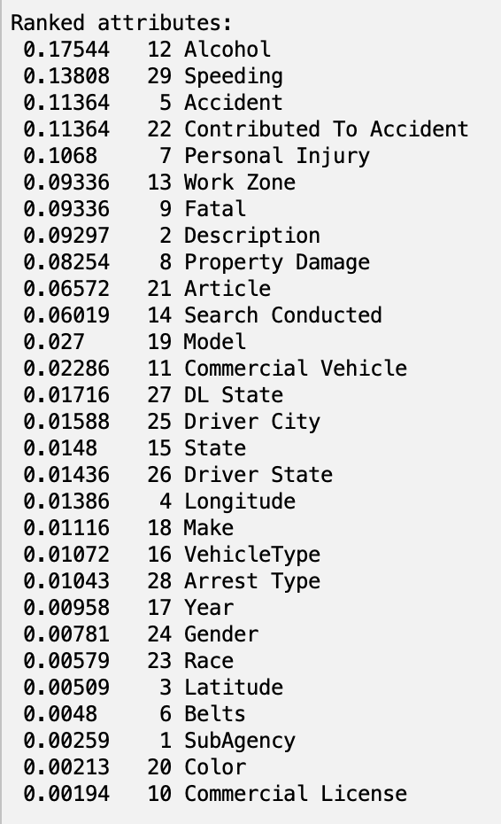
A
B
Selection Algorithms
Classification
InfoGain
GainRatio
OneR
WrapperSubset
Self-Chosen
InfoGain
GainRatio
IV. ATTRIBUTE SELECTION
Information gain / split info value
Cutoff of 0.05
Split on attribute to minimize entropy
Cutoff of 0.05

Slide 17
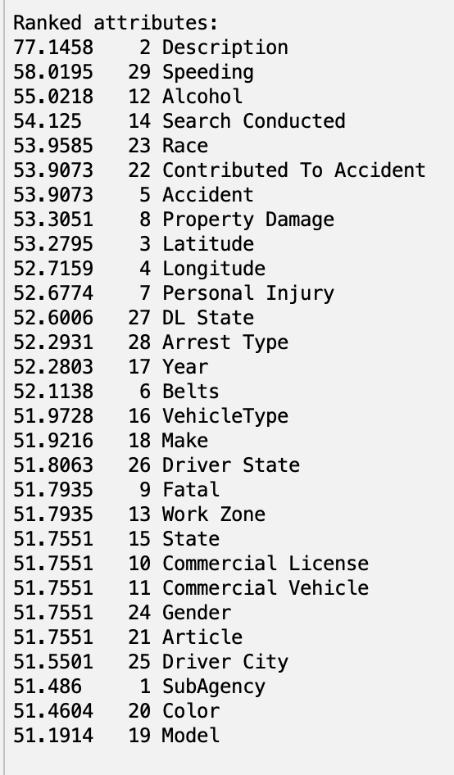
A
B
Selection Algorithms
Classification
InfoGain
GainRatio
OneR
WrapperSubset
Self-Chosen
OneR
One set of rules – 1 attribute
Cutoff of 53.3
InfoGain
GainRatio
Information gain / split info value
Cutoff of 0.05
Split on attribute to minimize entropy
Cutoff of 0.05

Slide 18
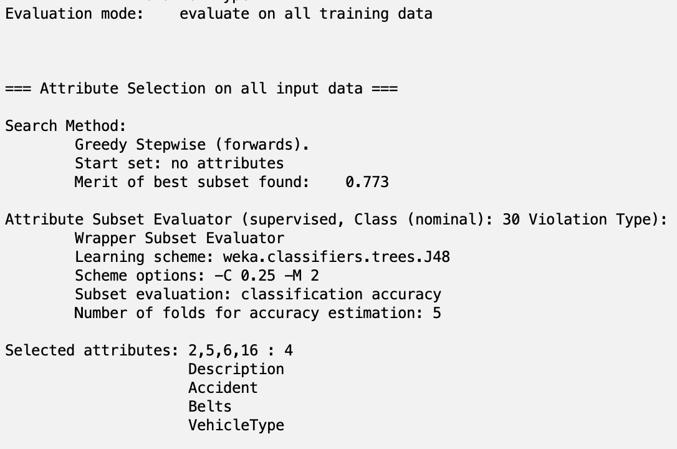
A
B
Selection Algorithms
Classification
InfoGain
GainRatio
OneR
WrapperSubset
Self-Chosen
OneR
WrapperSubset
One set of rules – 1 attribute
Cutoff of 53.3
Combinations of features
Tested with J48 tree
GainRatio
Information gain / split info value
Cutoff of 0.05

Slide 19
A
B
Selection Algorithms
Classification
InfoGain
GainRatio
OneR
WrapperSubset
Self-Chosen
WrapperSubset
Combinations of features
Tested with J48 tree
OneR
Self-Chosen
Using our knowledge of the data
Description
VehicleType
Search Conducted
Color
Race
Gender
Alcohol
Speeding
Arrest Type
One set of rules – 1 attribute
Cutoff of 53.3

Slide 20
A
B
Selection Algorithms
Classification
InfoGain
Split on attribute to minimize entropy
Cutoff of 0.05
GainRatio
Information gain / split info value
Cutoff of 0.05
OneR
One set of rules – 1 attribute
Cutoff of 53.3
WrapperSubset
Combinations of features
Tested with J48 tree
Self-Chosen
Using our knowledge of the data
Description
VehicleType
Search Conducted
Color
Race
Gender
Alcohol
Speeding
Arrest Type

Slide 21
A
B
Selection Algorithms
Classification
rules.DecisionTable
bayes.NaiveBayes
trees.J48
trees.RandomForest
InfoGain
Split on attribute to minimize entropy
Cutoff of 0.05
GainRatio
Information gain / split info value
Cutoff of 0.05
OneR
One set of rules – 1 attribute
Cutoff of 53.3
WrapperSubset
Combinations of features
Tested with J48 tree
Self-Chosen
Using our knowledge of the data
Description
VehicleType
Search Conducted
Color
Race
Gender
Alcohol
Speeding
Arrest Type

Slide 22
A
B
Selection Algorithms
Classification
rules.DecisionTable
bayes.NaiveBayes
trees.J48
trees.RandomForest
InfoGain
Split on attribute to minimize entropy
Cutoff of 0.05
GainRatio
Information gain / split info value
Cutoff of 0.05
OneR
One set of rules – 1 attribute
Cutoff of 53.3
WrapperSubset
Combinations of features
Tested with J48 tree
Self-Chosen
Using our knowledge of the data
Description
VehicleType
Search Conducted
Color
Race
Gender
Alcohol
Speeding
Arrest Type

Slide 23
B
Classification
rules.DecisionTable
bayes.NaiveBayes
trees.J48
trees.RandomForest
Creates a table of decisions from attributes
Each row: combination of attribute values
Final column: predicted class label
InfoGain
Split on attribute to minimize entropy
Cutoff of 0.05
GainRatio
Information gain / split info value
Cutoff of 0.05
OneR
One set of rules – 1 attribute
Cutoff of 53.3
WrapperSubset
Combinations of features
Tested with J48 tree
Self-Chosen
Using our knowledge of the data
Description
VehicleType
Search Conducted
Color
Race
Gender
Alcohol
Speeding
Arrest Type

Slide 24
B
Classification
rules.DecisionTable
bayes.NaiveBayes
trees.J48
trees.RandomForest
Creates a table of decisions from attributes
Each row: combination of attribute values
Final column: predicted class label
Assumes independence between attributes
Calculates probabilities for each class
Uses these to predict new instances
InfoGain
Split on attribute to minimize entropy
Cutoff of 0.05
GainRatio
Information gain / split info value
Cutoff of 0.05
OneR
One set of rules – 1 attribute
Cutoff of 53.3
WrapperSubset
Combinations of features
Tested with J48 tree
Self-Chosen
Using our knowledge of the data
Description
VehicleType
Search Conducted
Color
Race
Gender
Alcohol
Speeding
Arrest Type

Slide 25
B
rules.DecisionTable
bayes.NaiveBayes
trees.J48
trees.RandomForest
Classification
Creates a table of decisions from attributes
Each row: combination of attribute values
Final column: predicted class label
Assumes independence between attributes
Calculates probabilities for each class
Uses these to predict new instances
Recursively splits data by attribute
Chooses split based on highest gain ratio
Builds a decision tree for classification
InfoGain
Split on attribute to minimize entropy
Cutoff of 0.05
GainRatio
Information gain / split info value
Cutoff of 0.05
OneR
One set of rules – 1 attribute
Cutoff of 53.3
WrapperSubset
Combinations of features
Tested with J48 tree
Self-Chosen
Using our knowledge of the data
Description
VehicleType
Search Conducted
Color
Race
Gender
Alcohol
Speeding
Arrest Type

Slide 26








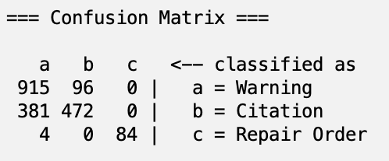
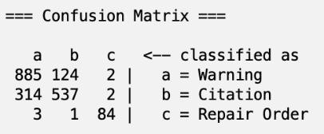






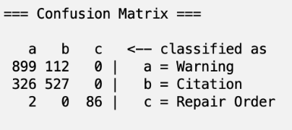


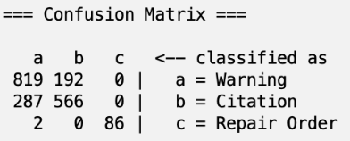
rules.DecisionTable
bayes.NaiveBayes
trees.J48
trees.RandomForest
B
Classification
Creates a table of decisions from attributes
Each row: combination of attribute values
Final column: predicted class label
Assumes independence between attributes
Calculates probabilities for each class
Uses these to predict new instances
Recursively splits data by attribute
Chooses split based on highest gain ratio
Builds a decision tree for classification
Builds multiple trees from random subsets
At each split, selects random attributes
Uses majority vote from trees for final prediction
V. FINAL
RESULTS
InfoGain
Split on attribute to minimize entropy
Cutoff of 0.05
InfoGain
GainRatio
Self
Chosen
Wrapper
Subset
GainRatio
OneR
Using DecisionTable
Using NaiveBayes
Using DecisionTable
Using NaiveBayes
Using DecisionTable
Using NaiveBayes
Using DecisionTable
Using NaiveBayes
Using DecisionTable
Using NaiveBayes
Information gain / split info value
Cutoff of 0.05
Using J48
Using RandomForest
Using J48
Using RandomForest
Using J48
Using RandomForest
Using J48
Using J48
Using RandomForest
Using RandomForest
OneR
One set of rules – 1 attribute
Cutoff of 53.3
WrapperSubset
Combinations of features
Tested with J48 tree
Self-Chosen
Using our knowledge of the data
Description
VehicleType
Search Conducted
Color
Race
Gender
Alcohol
Speeding
Arrest Type

Slide 27
rules.DecisionTable
bayes.NaiveBayes
trees.J48
trees.RandomForest
B
Classification
Recursively splits data by attribute
Chooses split based on highest gain ratio
Builds a decision tree for classification
Builds multiple trees from random subsets
At each split, selects random attributes
Uses majority vote from trees for final prediction
V. FINAL
RESULTS
InfoGain
GainRatio
Self
Chosen
Wrapper
Subset
OneR
Using DecisionTable
Using NaiveBayes
Using DecisionTable
Using NaiveBayes
Using DecisionTable
Using NaiveBayes
Using DecisionTable
Using NaiveBayes
Using DecisionTable
Using NaiveBayes
Using J48
Using RandomForest
Using J48
Using RandomForest
Using J48
Using RandomForest
Using J48
Using J48
Using RandomForest
Using RandomForest

Slide 28
V. FINAL
RESULTS
InfoGain
Using DecisionTable
Using NaiveBayes
Using J48
Using RandomForest
GainRatio
Self
Chosen
Wrapper
Subset
OneR
Using DecisionTable
Using NaiveBayes
Using DecisionTable
Using NaiveBayes
Using DecisionTable
Using NaiveBayes
Using DecisionTable
Using NaiveBayes
Using J48
Using RandomForest
Using J48
Using RandomForest
Using J48
Using J48
Using RandomForest
Using RandomForest

Slide 29
V. FINAL
RESULTS
InfoGain
GainRatio
Using DecisionTable
Using NaiveBayes
Using DecisionTable
Using NaiveBayes
Using J48
Using RandomForest
Using J48
Using RandomForest
Self
Chosen
Wrapper
Subset
OneR
Using DecisionTable
Using NaiveBayes
Using DecisionTable
Using NaiveBayes
Using DecisionTable
Using NaiveBayes
Using J48
Using RandomForest
Using J48
Using J48
Using RandomForest
Using RandomForest

Slide 30
V. FINAL
RESULTS
InfoGain
GainRatio
OneR
Using DecisionTable
Using NaiveBayes
Using DecisionTable
Using NaiveBayes
Using DecisionTable
Using NaiveBayes
Using J48
Using RandomForest
Using J48
Using RandomForest
Using J48
Using RandomForest
Self
Chosen
Wrapper
Subset
Using DecisionTable
Using NaiveBayes
Using DecisionTable
Using NaiveBayes
Using J48
Using J48
Using RandomForest
Using RandomForest

Slide 31
V. FINAL
RESULTS
InfoGain
GainRatio
Wrapper
Subset
OneR
Using DecisionTable
Using NaiveBayes
Using DecisionTable
Using NaiveBayes
Using DecisionTable
Using NaiveBayes
Using DecisionTable
Using NaiveBayes
Using J48
Using RandomForest
Using J48
Using RandomForest
Using J48
Using RandomForest
Using J48
Using RandomForest
Self
Chosen
Using DecisionTable
Using NaiveBayes
Using J48
Using RandomForest

Slide 32
V. FINAL
RESULTS
InfoGain
GainRatio
Self
Chosen
Wrapper
Subset
OneR
Using DecisionTable
Using NaiveBayes
Using DecisionTable
Using NaiveBayes
Using DecisionTable
Using NaiveBayes
Using DecisionTable
Using NaiveBayes
Using DecisionTable
Using NaiveBayes
Using J48
Using RandomForest
Using J48
Using RandomForest
Using J48
Using RandomForest
Using J48
Using RandomForest
Using J48
Using RandomForest
Summary
 | InfoGain | GainRatio | OneR | WrapperSubset | Self-Chosen
DecisionTable | 75.36 | 75.56 | 75.56 | 75.56 | 75.36
NaiveBayes | 74.28 | 78.84 | 78.64 | 76.74 | 77.15
J48 | 76.38 | 77.87 | 77.77 | 77.05 | 77.46
RandomForest | 75.41 | 78.64 | 77.92 | 77.1 | 75.36

Slide 33
InfoGain
GainRatio
Self
Chosen
Wrapper
Subset
OneR
Using DecisionTable
Using NaiveBayes
Using DecisionTable
Using NaiveBayes
V. FINAL
RESULTS
Using DecisionTable
Using NaiveBayes
Using DecisionTable
Using NaiveBayes
Using DecisionTable
Using NaiveBayes
Using J48
Using RandomForest
Using J48
Using RandomForest
Using J48
Using RandomForest
Using J48
Using RandomForest
Using J48
Using RandomForest
Summary
 | InfoGain | GainRatio | OneR | WrapperSubset | Self-Chosen
DecisionTable | 75.36 | 75.56 | 75.56 | 75.56 | 75.36
NaiveBayes | 74.28 | 78.84 | 78.64 | 76.74 | 77.15
J48 | 76.38 | 77.87 | 77.77 | 77.05 | 77.46
RandomForest | 75.41 | 78.64 | 77.92 | 77.1 | 75.36
Gain Ratio
With NaïveBayes
0.325
78.84%

Slide 34
Summary
InfoGain
GainRatio
Self
Chosen
Wrapper
Subset
OneR
Using DecisionTable
Using NaiveBayes
Using DecisionTable
Using NaiveBayes
V. FINAL
RESULTS
Using DecisionTable
Using NaiveBayes
 | InfoGain | GainRatio | OneR | WrapperSubset | Self-Chosen
DecisionTable | 75.36 | 75.56 | 75.56 | 75.56 | 75.36
NaiveBayes | 74.28 | 78.84 | 78.64 | 76.74 | 77.15
J48 | 76.38 | 77.87 | 77.77 | 77.05 | 77.46
RandomForest | 75.41 | 78.64 | 77.92 | 77.1 | 75.36
Using DecisionTable
Using NaiveBayes
Using DecisionTable
Using NaiveBayes
Using J48
Using RandomForest
Using J48
Using RandomForest
Using J48
Using RandomForest
Using J48
Using RandomForest
Using J48
Using RandomForest
Gain Ratio
With NaïveBayes
0.325
78.84%
(FP rate, warnings)

Slide 35
Reproduction
Open Weka and load train_split.csv (located in the “Cleaned Data” folder of our Google Drive folder).
Ensure “Violation Type” is already set as the class variable. If not, open the Editor by clicking the “Edit…” button, right click on “Violation Type,” select “Attribute as class,” and click “OK.”
Go to the “Select attributes” tab, click the top “Choose” button in the “Attribute Evaluator” box, and select “GainRatioAttributeEval.” Click “Yes” on the alert that pops up to switch to the Ranker search method.
Click on the Search Method box where it says “Ranker,” and in the resulting popup, change the number in threshold to 0.05. Click OK.
Set the class by clicking on “No class” and changing it to “(Nom) Violation Type.”
Click Start.
The window will show the attributes to be kept. Keep these and the class label Violation Type, remove all of the other attributes in the Preprocess tab.
For future use, save this train dataset as an arff file.
Open the Classify tab, click Choose, open the bayes folder, and select NaiveBayes.
Under Test Options, choose “Supplied test set,” then “Open file…” and select train_split.csv (located in the “Cleaned Data” folder of our Google Drive folder). Ensure the Class dropdown box has “(Nom) Violation Type” selected; if not, select it. Click Close.
Click Start.
The model will be created and its output will appear in the output window.
?
Q

Slide 36
Sources
DecisionTable. (n.d.). In WEKA Documentation. https://weka.sourceforge.io/doc.dev/weka/classifiers/rules/DecisionTable.html
GainRatioAttributeEval. (n.d.). In WEKA Documentation. https://weka.sourceforge.io/doc.dev/weka/attributeSelection/GainRatioAttributeEval.html
InfoGainAttributeEval. (n.d.). In WEKA Documentation. https://weka.sourceforge.io/doc.dev/weka/attributeSelection/InfoGainAttributeEval.html
J48. (n.d.). In WEKA Documentation. https://weka.sourceforge.io/doc.dev/weka/classifiers/trees/J48.html
NaiveBayes. (n.d.). In WEKA Documentation. https://weka.sourceforge.io/doc.dev/weka/classifiers/bayes/NaiveBayes.html
OneRAttributeEval. (n.d.). In WEKA Documentation. https://weka.sourceforge.io/doc.dev/weka/attributeSelection/OneRAttributeEval.html
RandomForest. (n.d.). In WEKA Documentation. https://weka.sourceforge.io/doc.dev/weka/classifiers/trees/RandomForest.html
WrapperSubsetEval. (n.d.). In WEKA Documentation. https://weka.sourceforge.io/doc.dev/weka/attributeSelection/WrapperSubsetEval.html

Slide 37
Thank you for your undivided and desegregated attention and concentration!
We hope you enjoyed this intellectual and spiritual journey through the realm of machine Learning models

